Slide 1

INSERT COIN

Slide 2

What is Insert Coin?
Bright Pixel program that helps entrepreneurs build a startup from ground up.
3 key messages:
It’s not about good ideas, it’s about excellent execution;
Market validation is king;
Failure is a learning (& sharing) opportunity;
and 1 rule:
Don’t blame anyone but yourself.

Slide 3








How does it work?
CHOOSE
LET’S PLAY
LEVEL UP
GAME OVER
the idea
Build the idea
Fundraising time
Continue?
You have the drive to be an entrepreneur but you are short on inspiration?
No problem. We prepared a list for you.
You already have an idea? Great, let us hear about it.
Let’s build that MVP and test it with real clients. We can help with:
Take it to the next level and unleash your product’s full potential.
Our fund works like financial muscle, supporting your early-stage needs.
Failure is part of the learning process.
Share your experience and listen to fellow entrepreneurs.
Office
Space
Designers
IT
Tools
Tech
Support
Legal
Support
Infra-
Structure
Coffee
Machine
Testbed
with clients

Slide 4


And what is Game On?
2 month pre-acceleration program
where entrepreneurs will solve corporates’ challenges and build a startup along the way.
Organised by:

Slide 5




What will happen?
Companies submit challenges that they’re facing
Entrepreneurs or startups choose challenges to address
Entrepreneurs / startups are matched with corporates and pilot their products
Product is pitched in a final event that will celebrate entrepreneurship and Reactor’s anniversary

Slide 6
Timeline
1 month
1 month
1 day
2 months
1 day
Corporate challenge submission
Entrepreneur/Startup
application
Kickoff event
Pre-acceleration program
Final event
Roadshow through corporates (targeting first the ones associated with Reactor and then the ones with open innovation programs)
Bizdev (Sponsorships)
Ideation program to create the challenges;
Publish ideas/challenges in the Insert Coin website
Roadshow through:
. Incubators
. Universities
. Direct invitations to startups
Candidates evaluation
Mentorship sections;
Know your client sessions;
Pilot solutions;

Slide 7
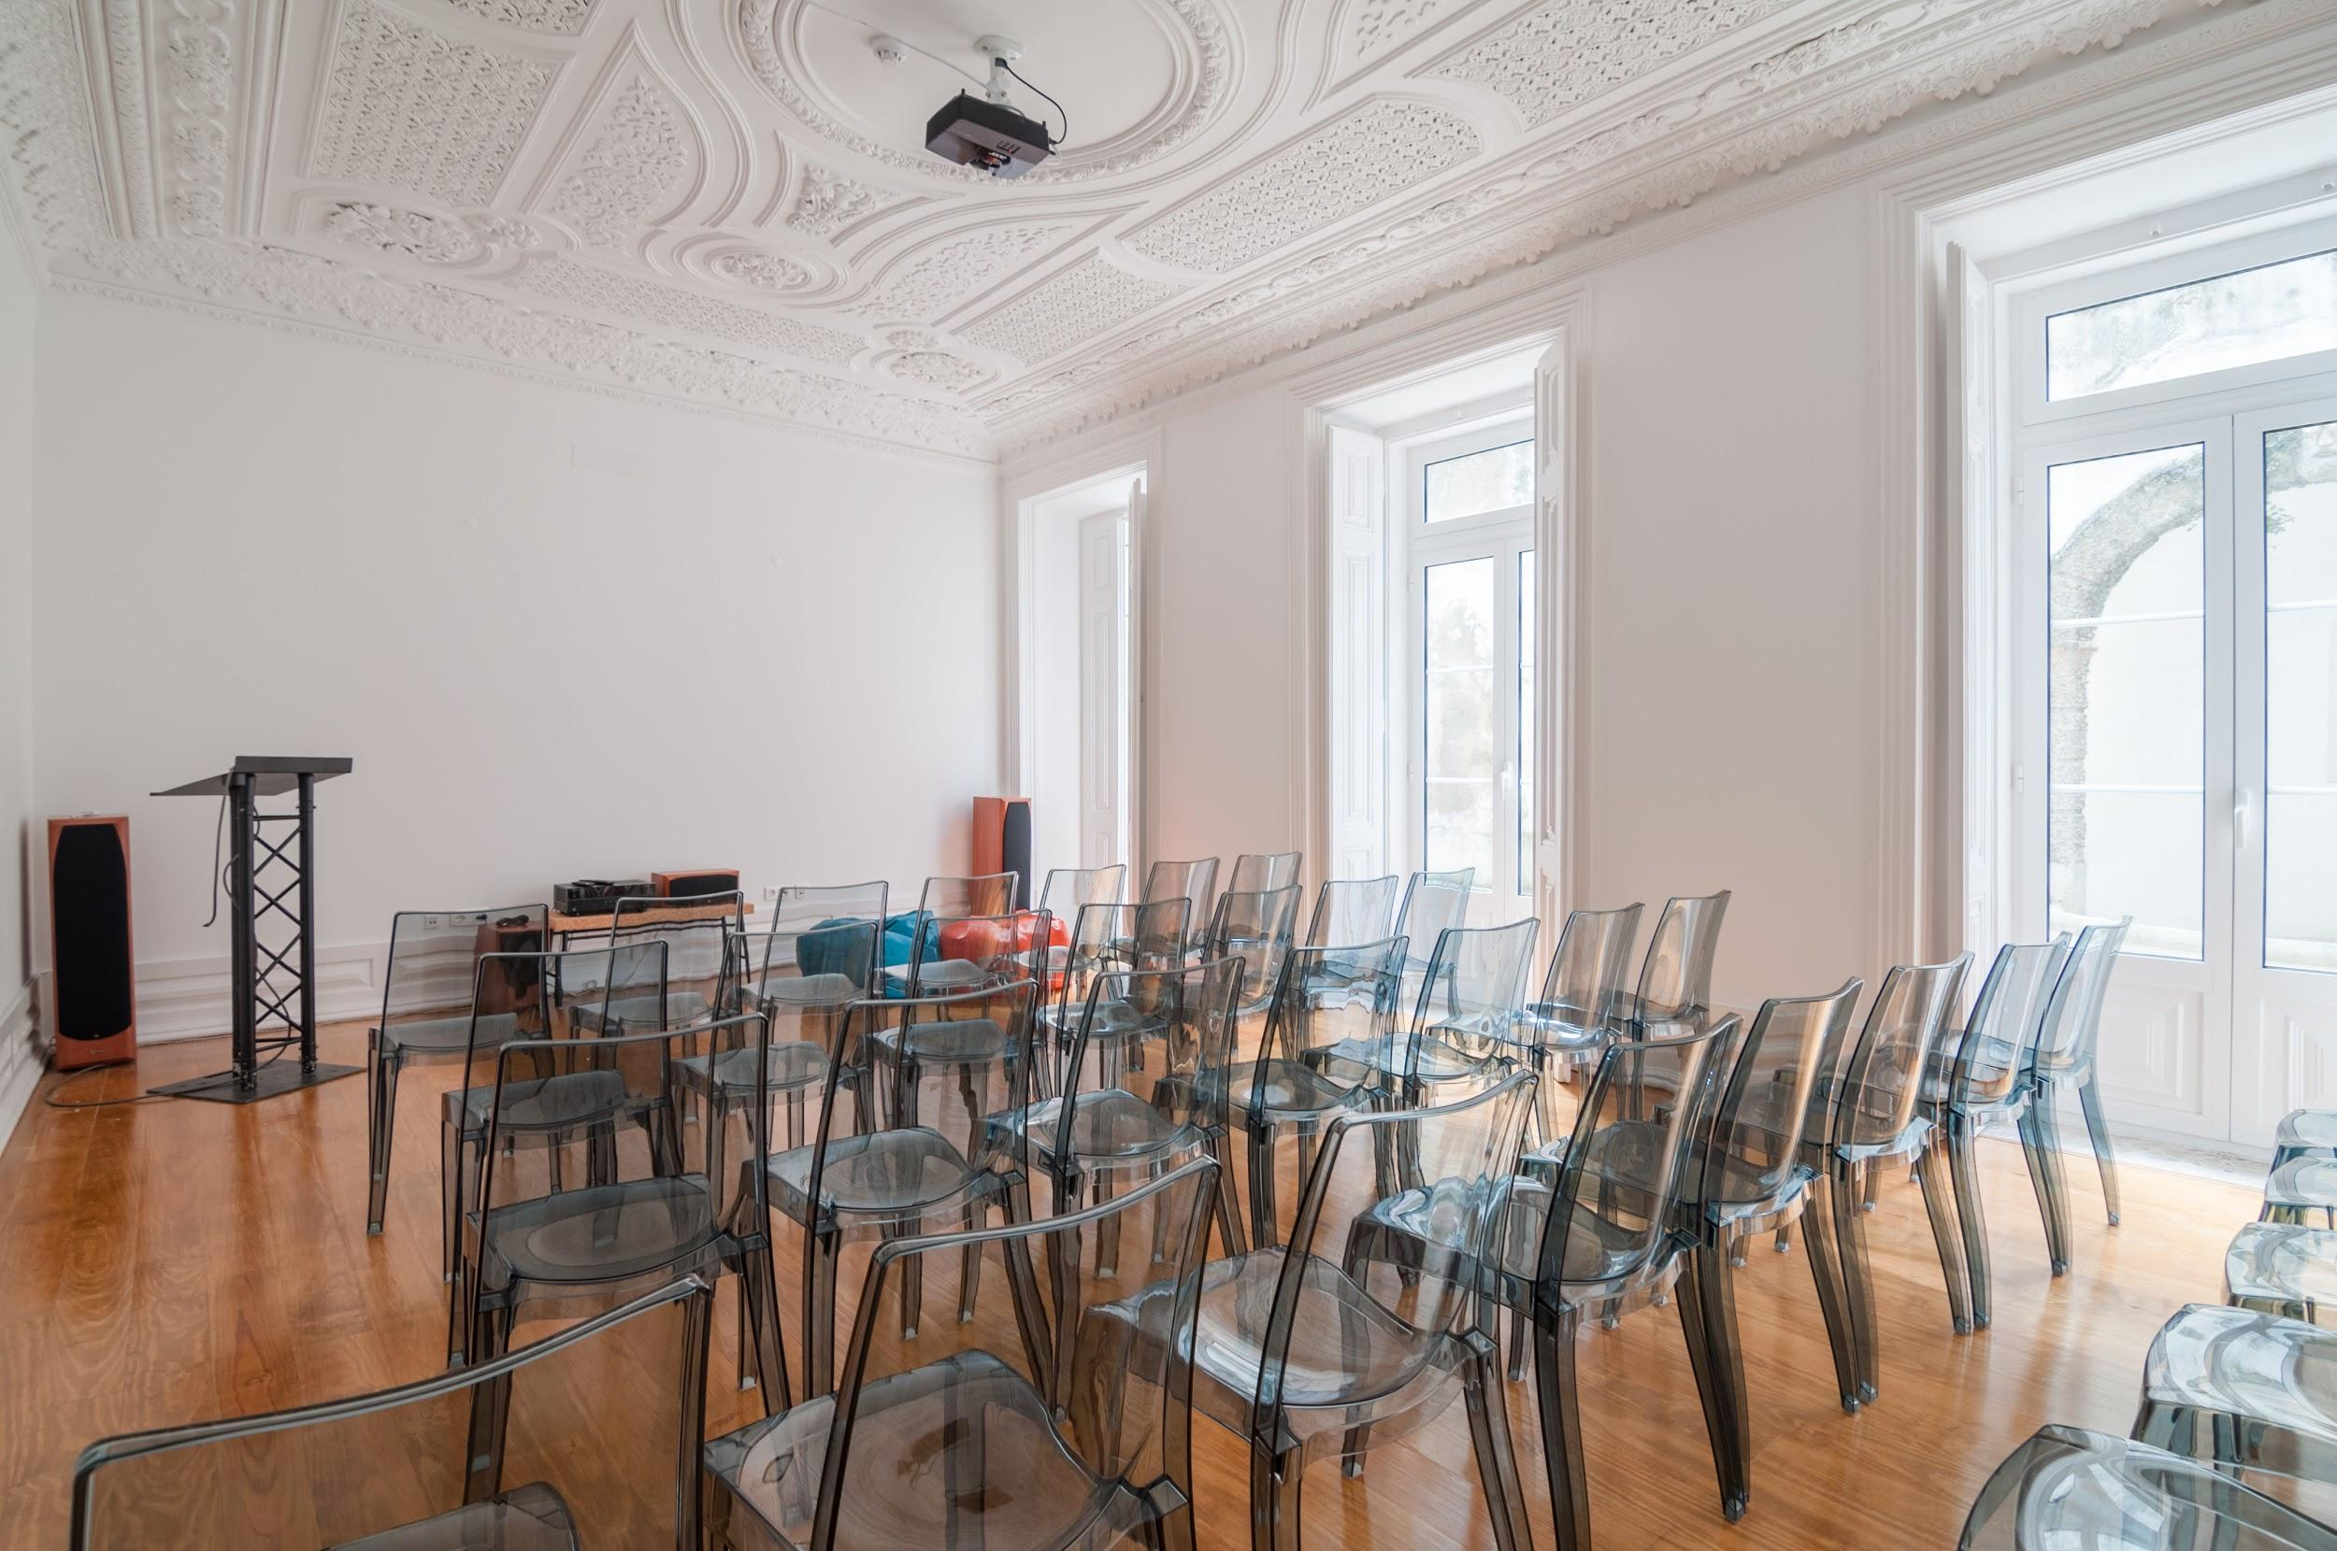

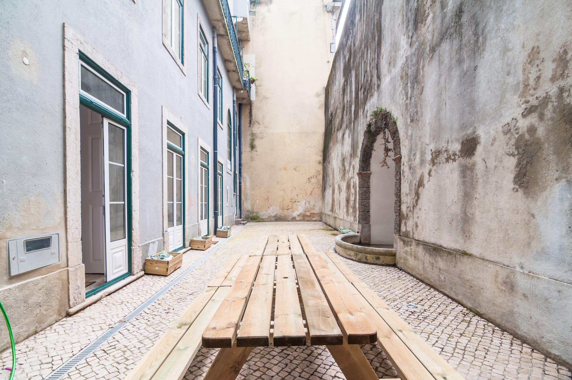
Kickoff Event
The kickoff event marks the beginning of the acceleration. To ease up the onboard of everyone, the key objective is networking.
This event will be held at Bright Pixel headquarters, at the 18th of October (to be confirmed).
Preliminary agenda:
Welcome: Celso Martinho (BRPX), PBS, Lionesa
Talk: João Sil (BRPX) - 6 months features into a 2 month sprint.
Coffee Break
Round table between Challenge Makers and Respondents
Beers

Slide 8
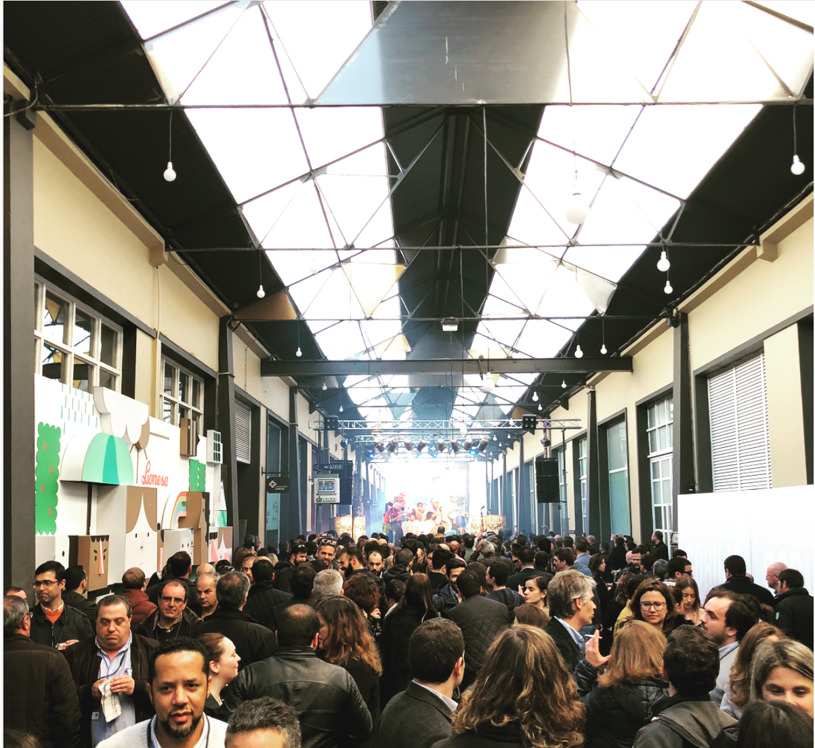
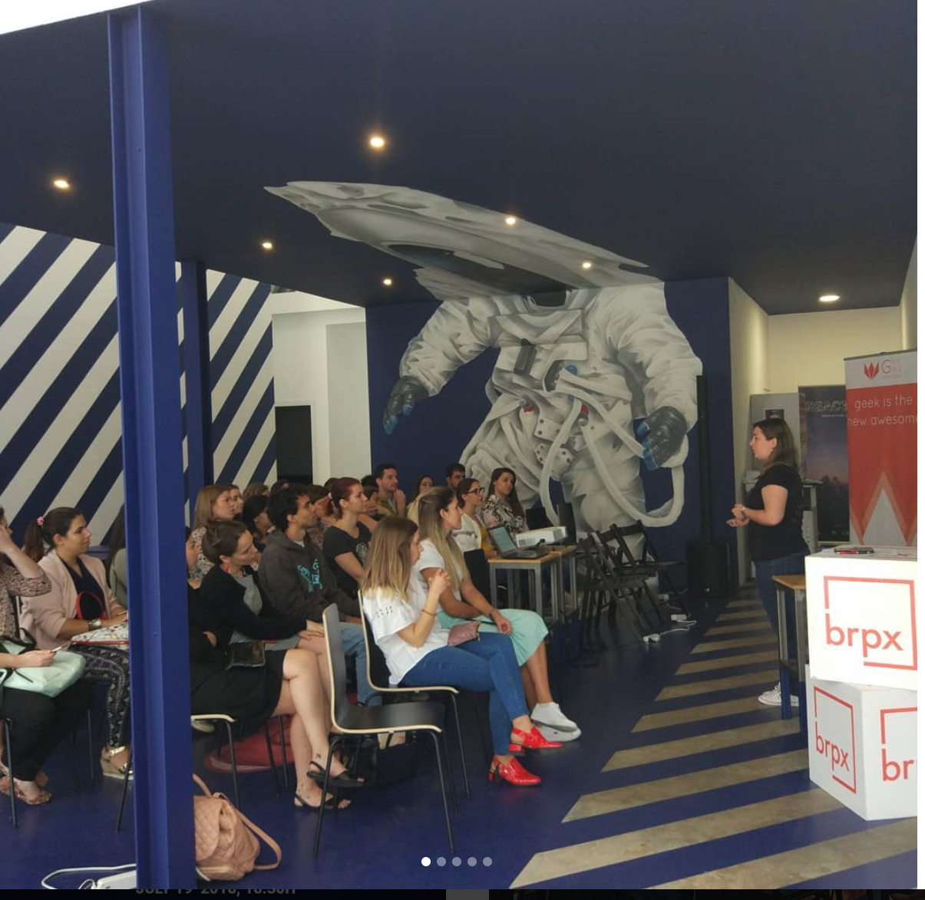
Final Event
The final event will be held at Lionesa Space in the 2nd week of January (subject to confirmation), when Reactor will celebrate its first anniversary.
Preliminary agenda:
Keynote: Claudia Azevedo, Sonae
Talks Main Stage
Talks Reactor Stage
Workshop
. Failure
. Computer Vision
. Blockchain
. Intellectual Property
. Cybersecurity
. Investors Pitch
. Gamification
. PBS Talk
. Serious Lego
. Blockchain/ICOs
. PBS Talk
Pitching contest
Awards

Slide 9

Sponsorship Packages (preliminary)
GAME ON
SPONSORSHIP
FINAL EVENT
SILVER SPONSORSHIP
FINAL EVENT
GOLD SPONSORSHIP
Limited to 20 sponsors
Unlimited
Limited to 15 sponsors
General
Propose a Challenge
Mentorship
Tech Talk or Workshop
Invitations for Final Event
2 + mentor
3
10
Branding
Logo on Website
Sponsor Shoutout
Banner
Press Release mention
Gift Bag Goodies
Award Custom Prize
Stand
Price
TBD€ *
TBD€
TBD€
* will only be charged if there are applicants to the challenge

Slide 10








On Board
Powered by:
Media Sponsor:
Acceleration Partner:
Game On Sponsors
Gold Sponsors
Silver Sponsors

